Slide 1
Big Mountain Resort

Slide 2
Problem Identification
Big Mountain Resort has invested in a new chair lift to attract more guests but at the cost of an additional $1.54 million in operating costs per season.
How much can Big Mountain Resort increase its ticket price to offset its additional operating costs?
Or, can Big Mountain Resort reduce its seasonal operational costs to recoup the additional operating cost from the new lift?

Slide 3
Recommendation and Key Findings
Big Mountain resort can increase annual revenue by $2.1 million by increasing its ticket price by $1.24
In order to prevent the increased ticket price from detering guests, Big Mountain Resort must improve existing features.
Scenario 1: Increase vertical drop by 150 feet
Big Mountain Resort can reduce operational costs by cutting less popular features
Closing two runs appears to have no effect on ticket price
Closing three to six runs appears to require lowering ticket prices by $1.20
Closing seven to ten runs appears to require lowering ticket prices by $2.00
Recommendation: Increase vertical drop along with ticket price. Reduce resources to less popular resort features.

Slide 4
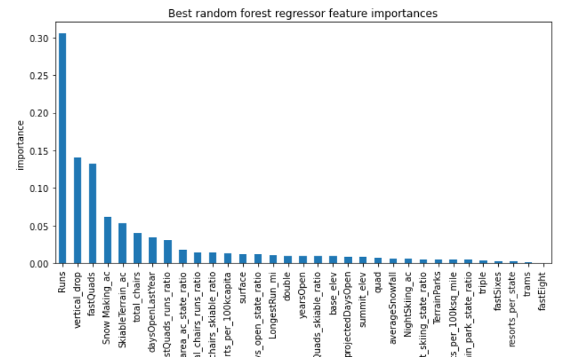
Modeling Results and Analysis
Top 4 features: Runs, Vertical Drops, FastQuads, and Snow Making AC

Slide 5
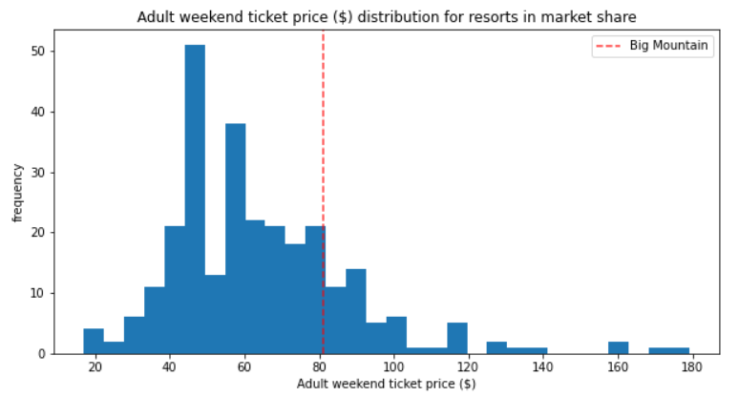
Modeling Results and Analysis
Plenty of other resorts have higher adult weekend ticket prices than Big Mountain.

Slide 6
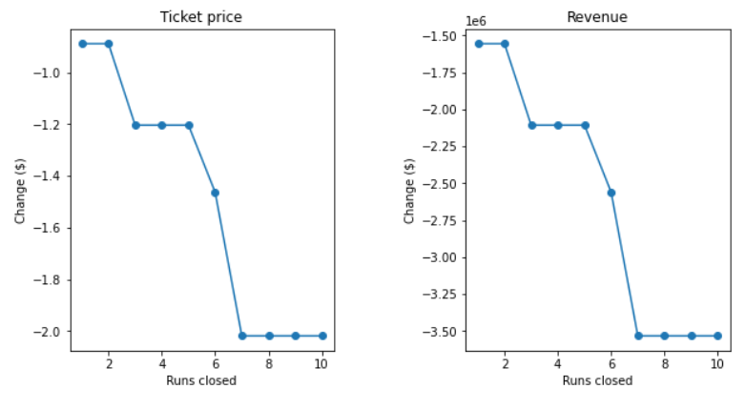
Modeling Results and Analysis
Ranges exist where ticket price can be increased without a decrease in visitors.

Slide 7
Summary
Big Mountain Resort can increase its revenue by…
Increasing adult weekend ticket prices, and
Decreasing operational costs by cutting resources to less popular features

